Slide 1
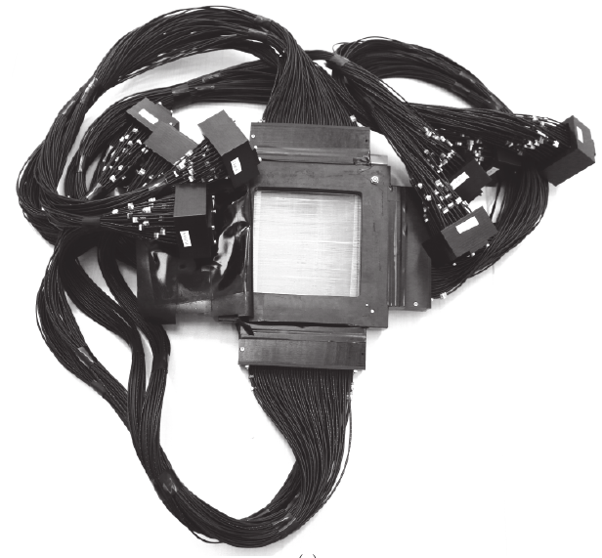
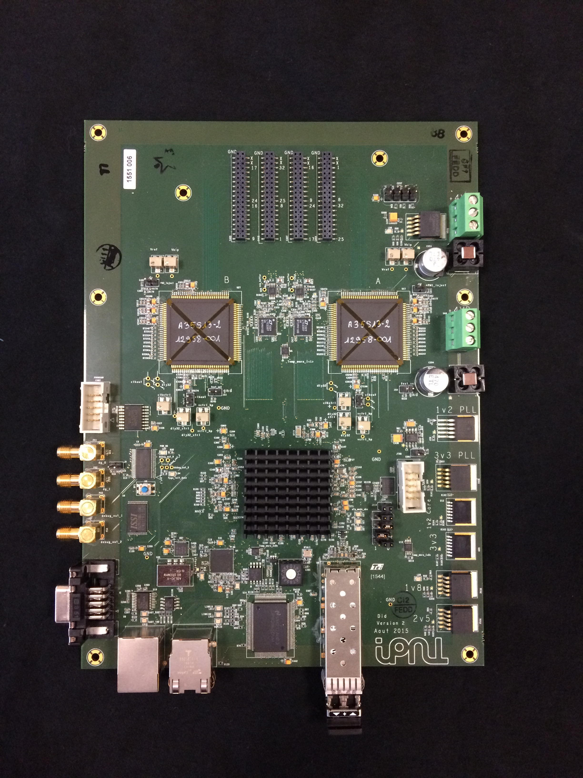
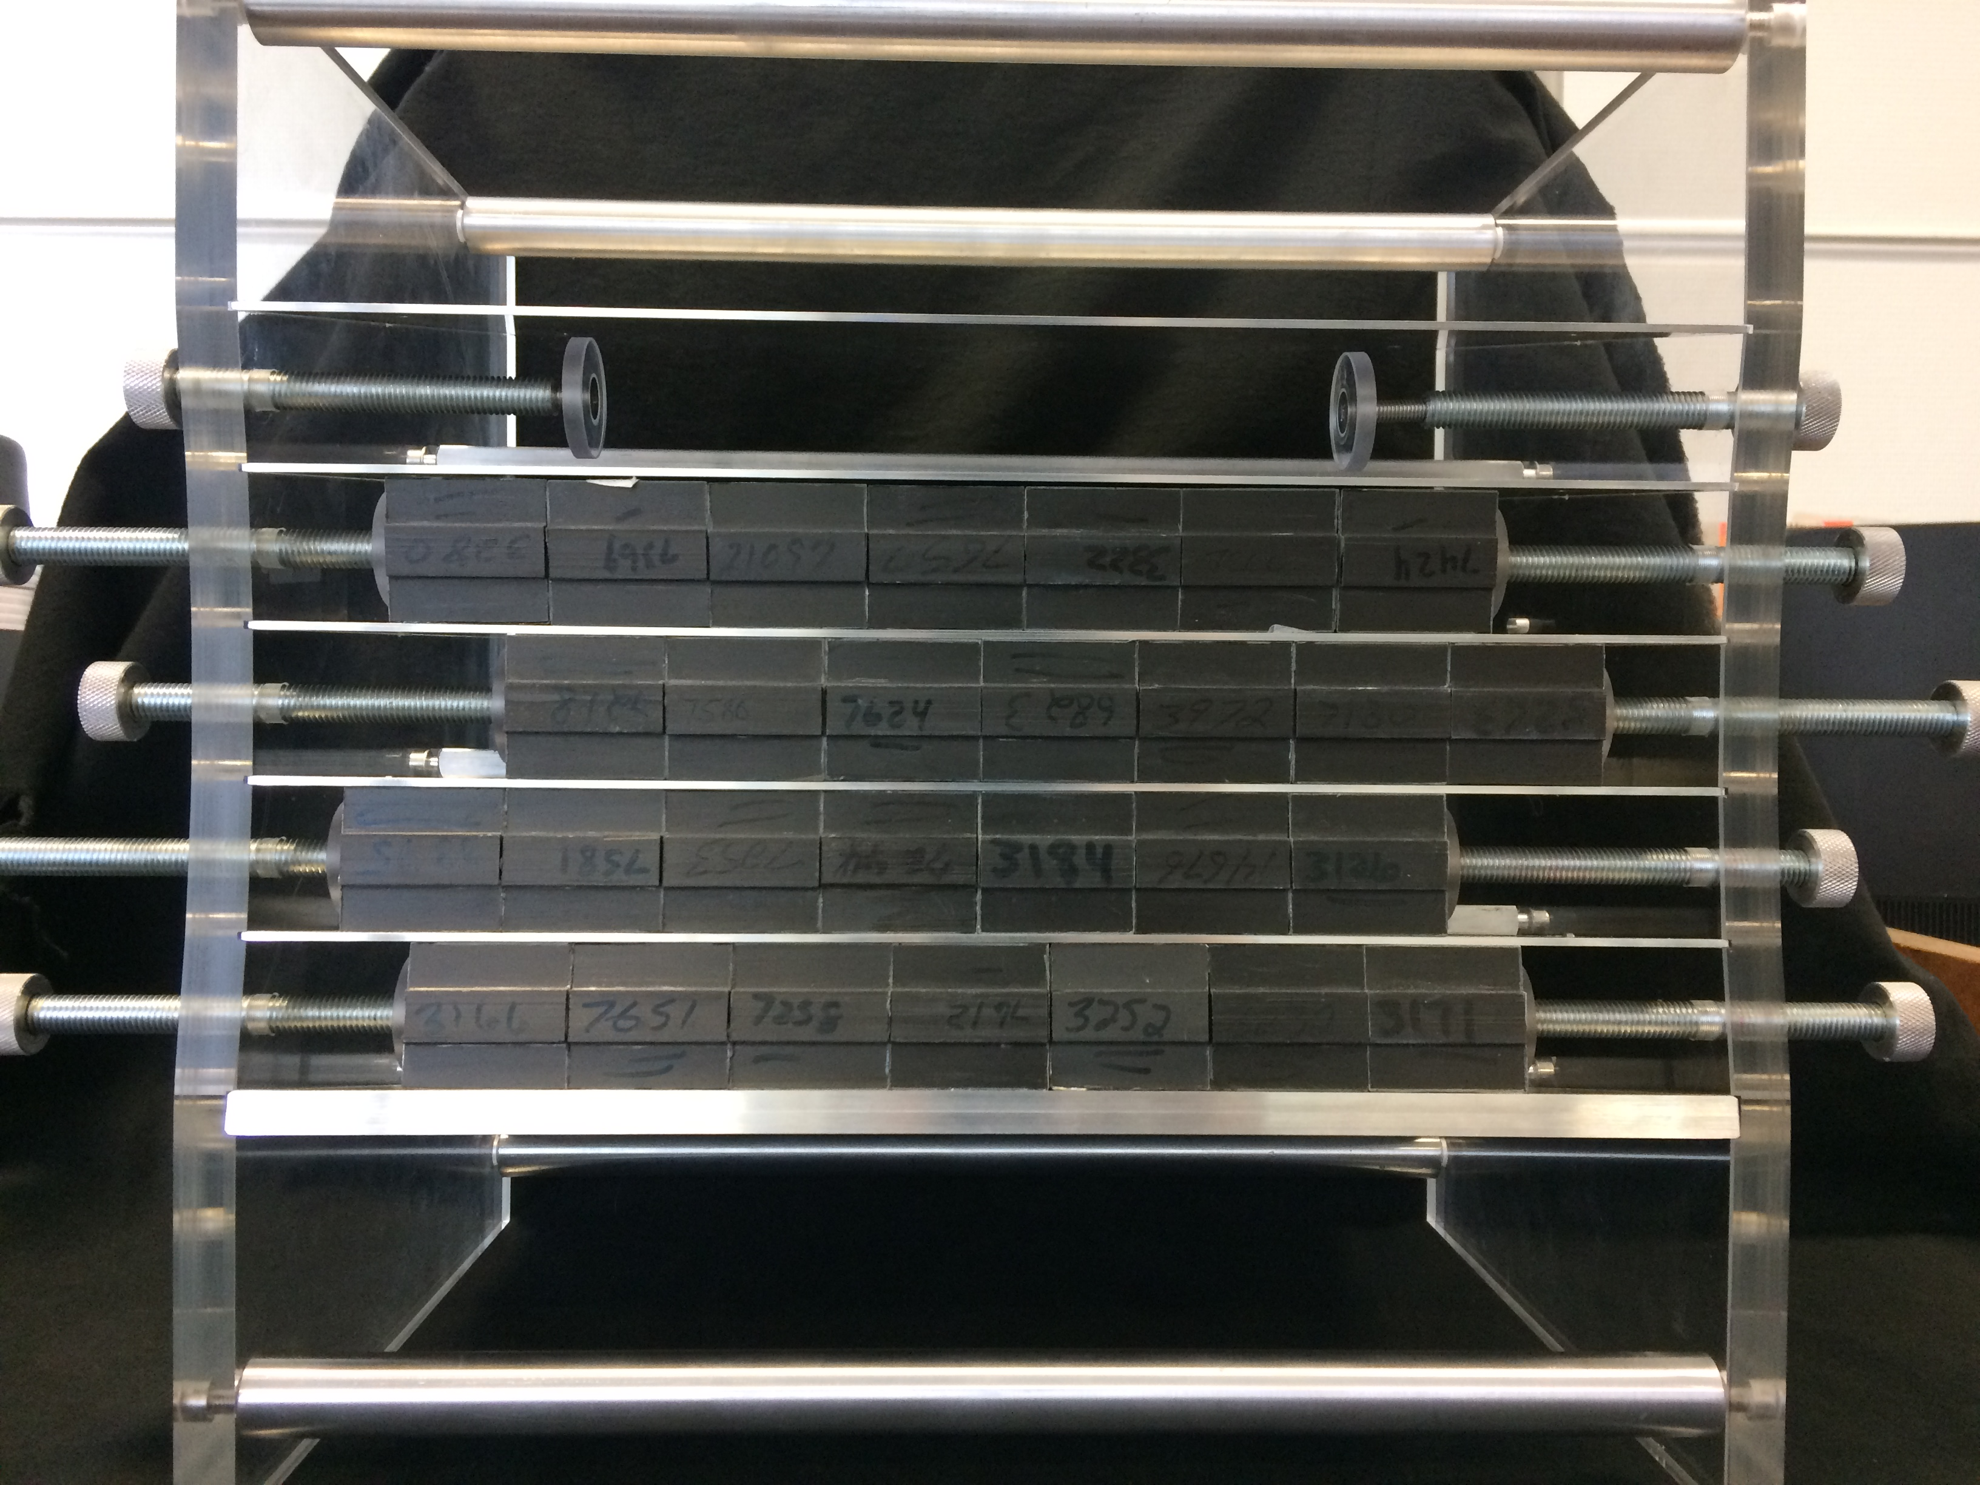
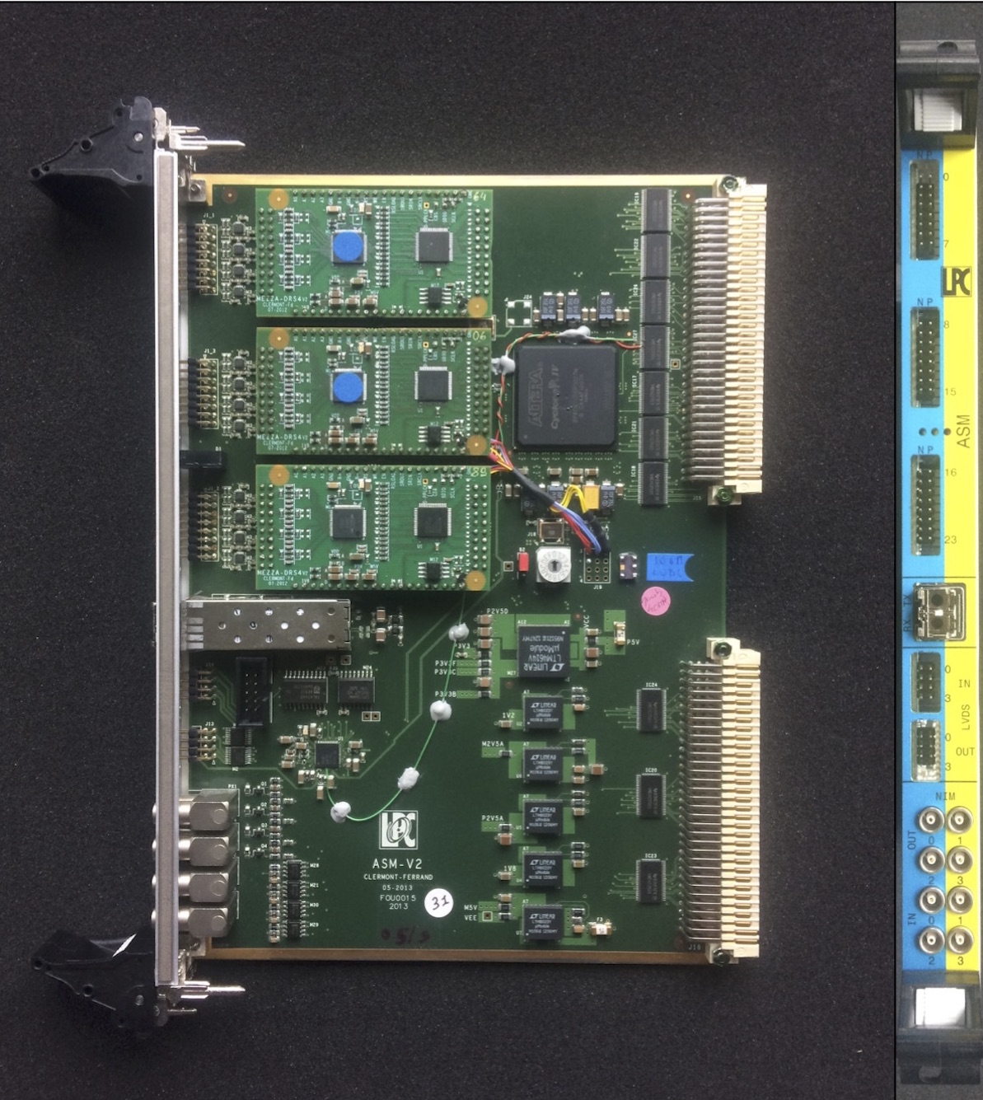
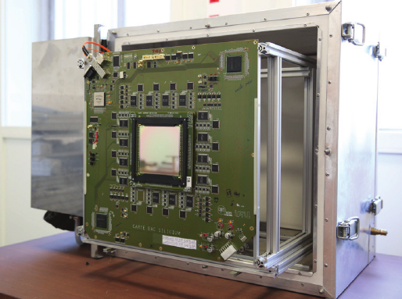
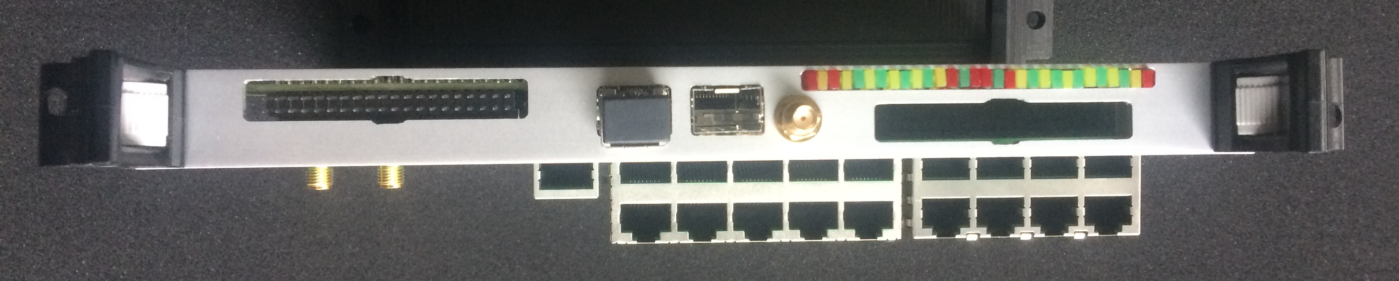

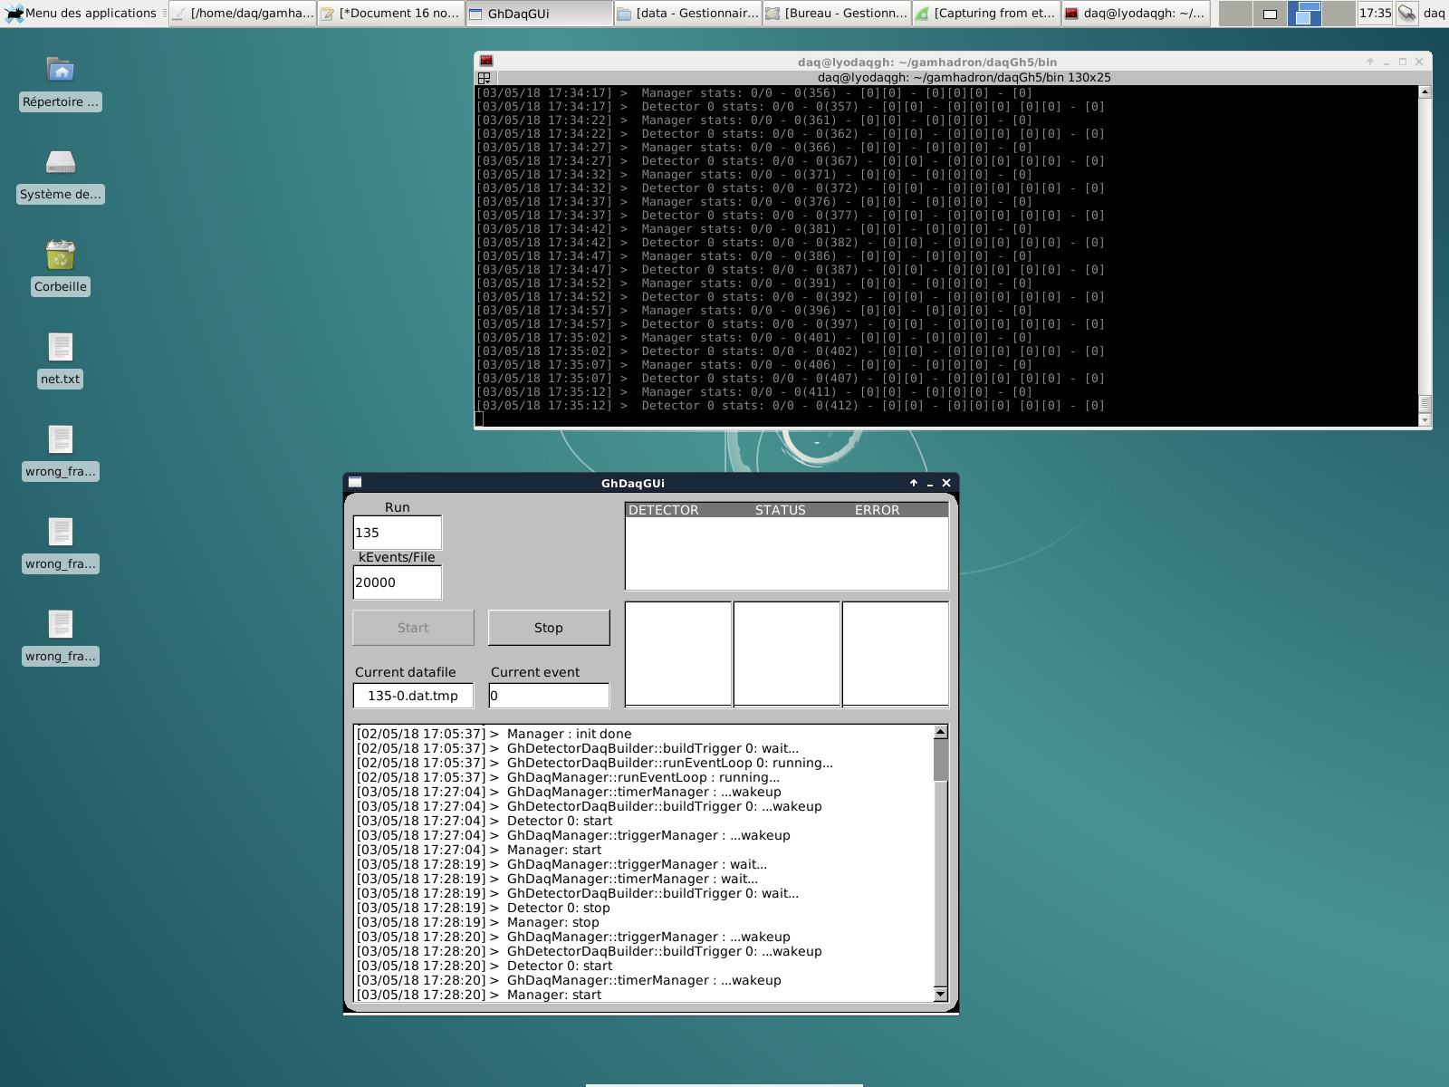
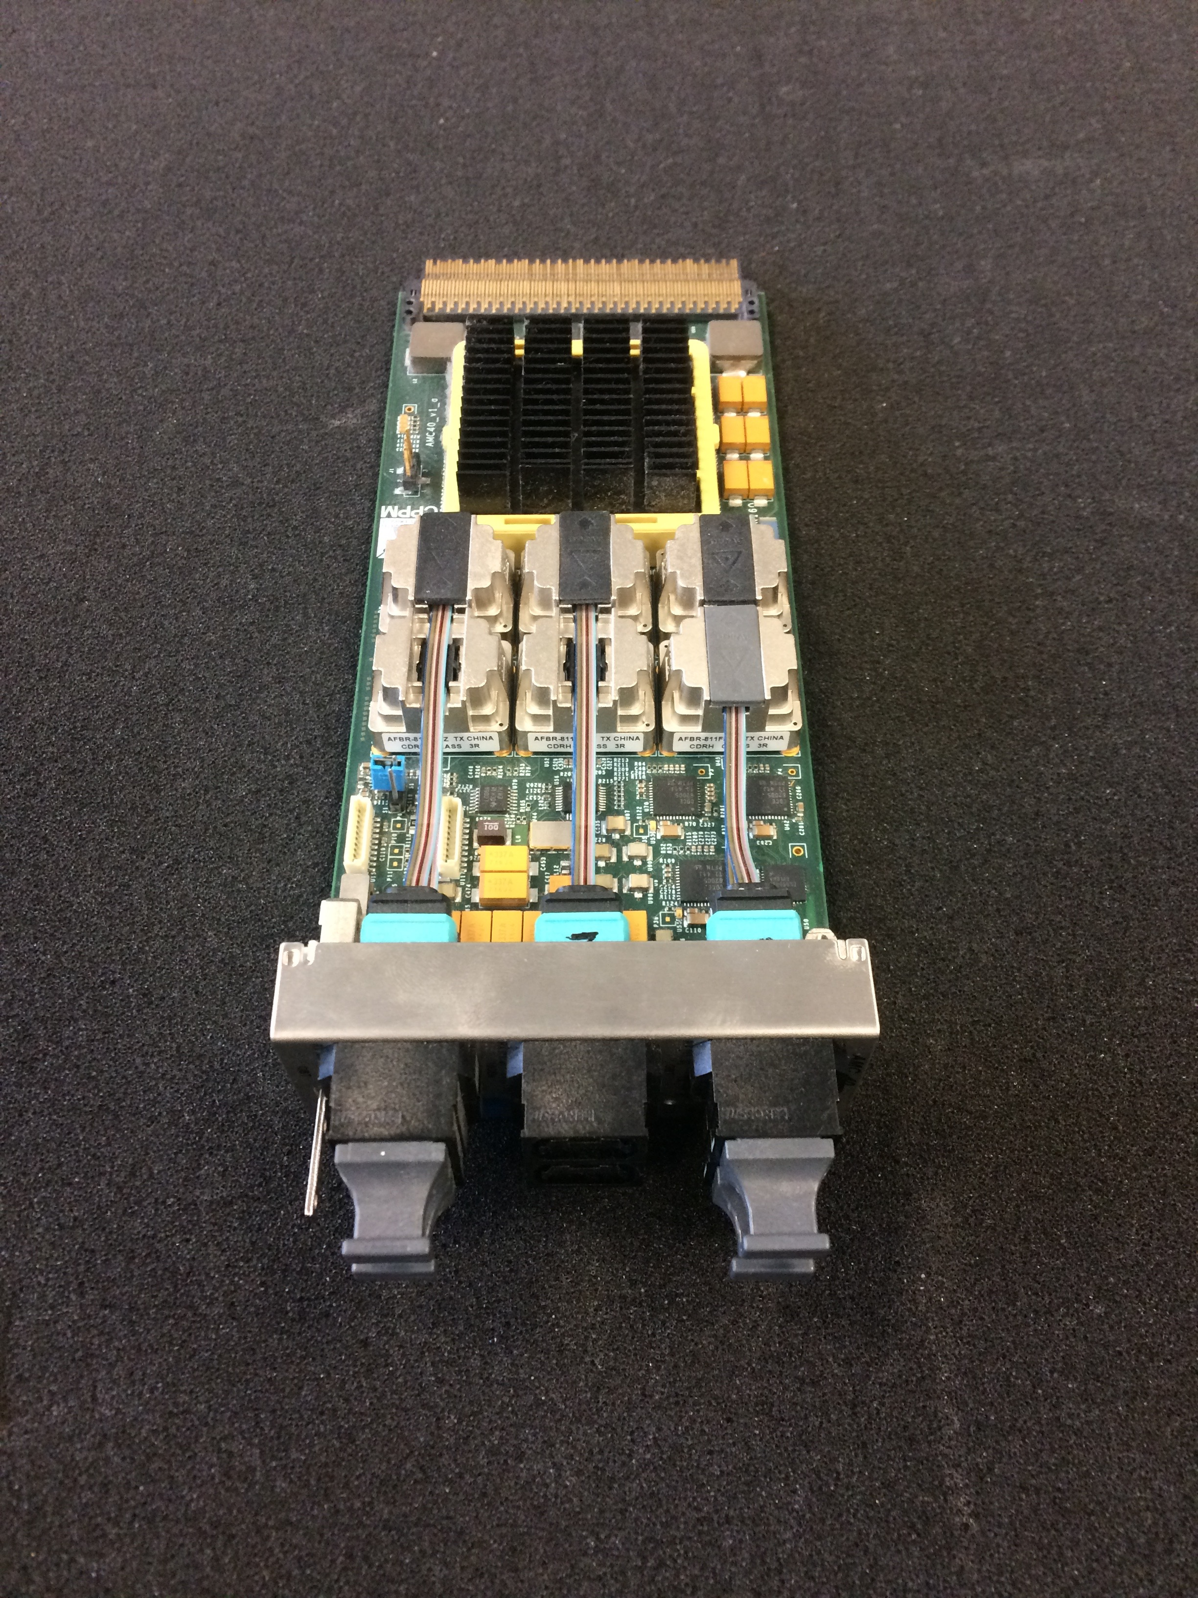
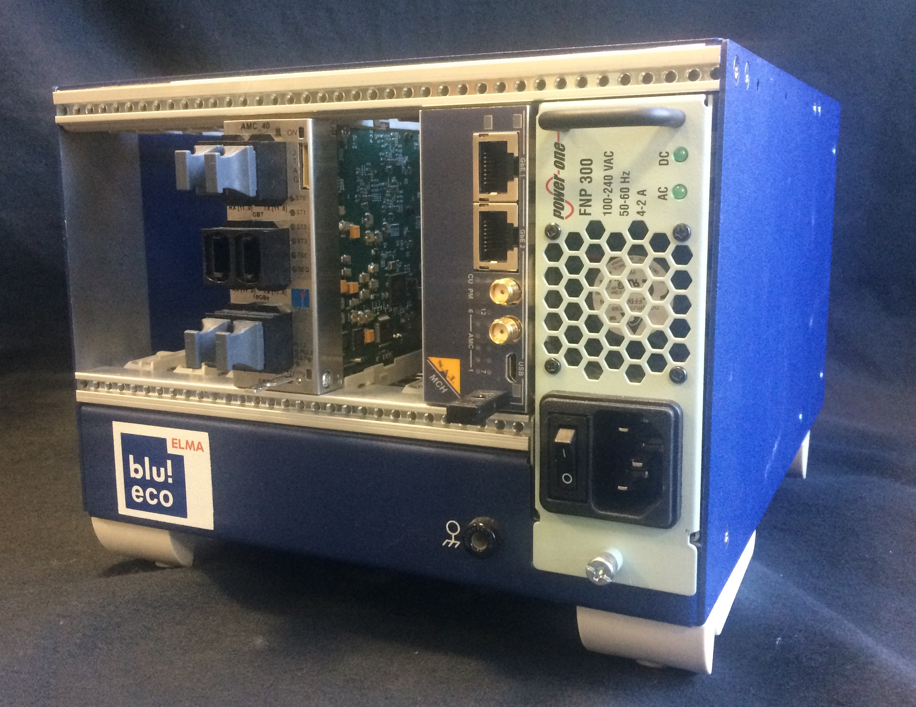
BEAM TAGGING HODOSCOPE
8 FE cards – 1 PM each
BGO ABSORBER
ASM read-out card – 6 blocks each
Si SCATTERER
7 FE cards – 1 per layer
THOR INTERMEDIATE CARD
Global clock handling
Pre-trigger
ACQUISITION PC
Trigger – if coincidence with pre-trigger
AMC40 &
μTCA crate
Data collection, packaging and sending via UDP link to the acquisition PC
DAQ software

Slide 2
BEAM TAGGING HODOSCOPE
8 FE cards – 1 PM each
BGO ABSORBER
ASM read-out card – 6 blocks each
Si SCATTERER
7 FE cards – 1 per layer
THOR INTERMEDIATE CARD
Global clock handling
ACQUISITION PC
AMC40 &
μTCA crate
Data collection, packaging and sending via UDP link to the acquisition PC
DAQ software

Slide 3
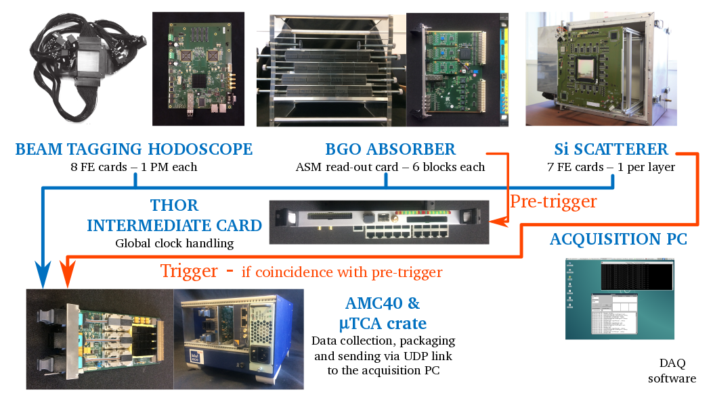

Slide 5

γ

